Slide 1
PRESIDENT’S REPORT
Mun Y. Choi
Board of Curators Meeting
September 2, 2021

Slide 2
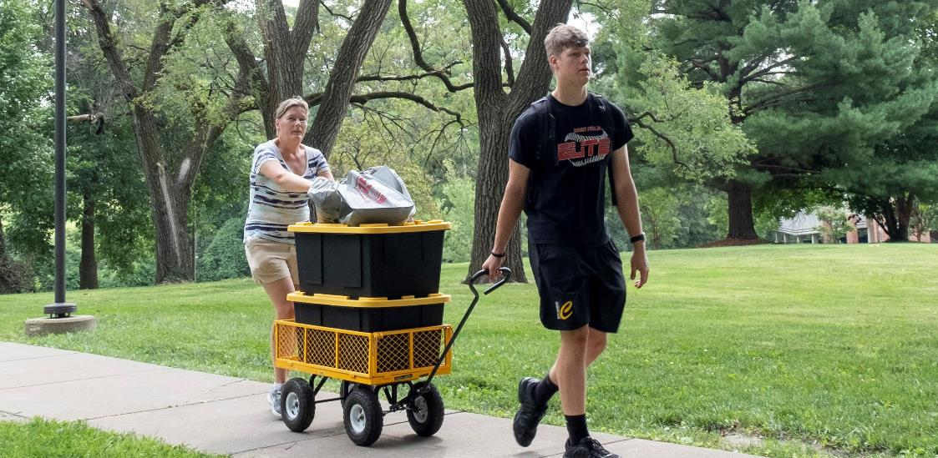
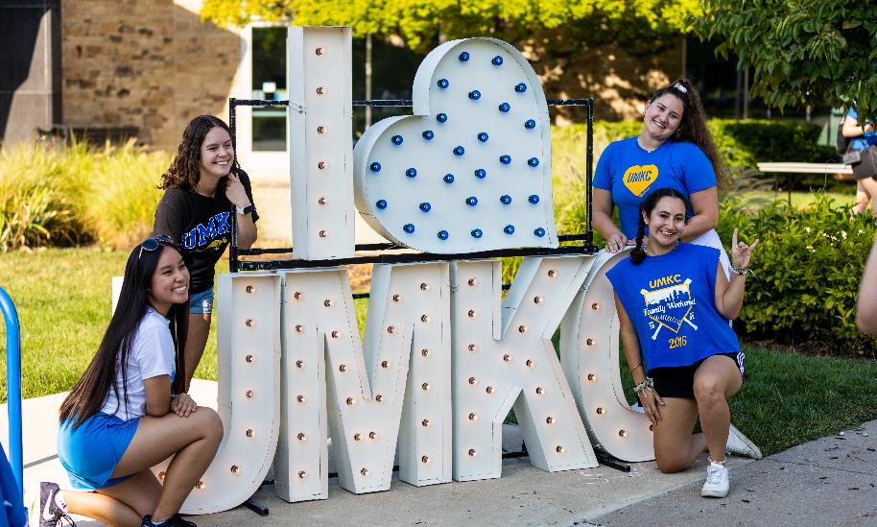
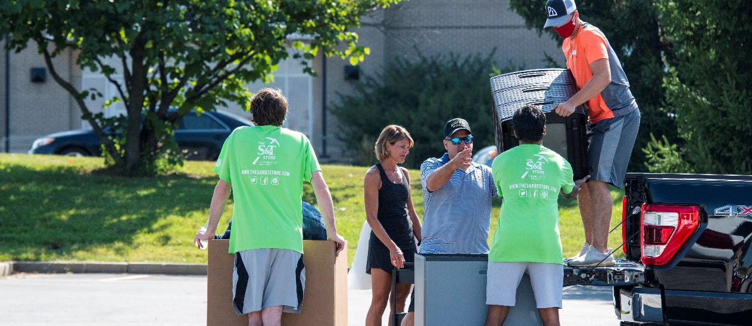
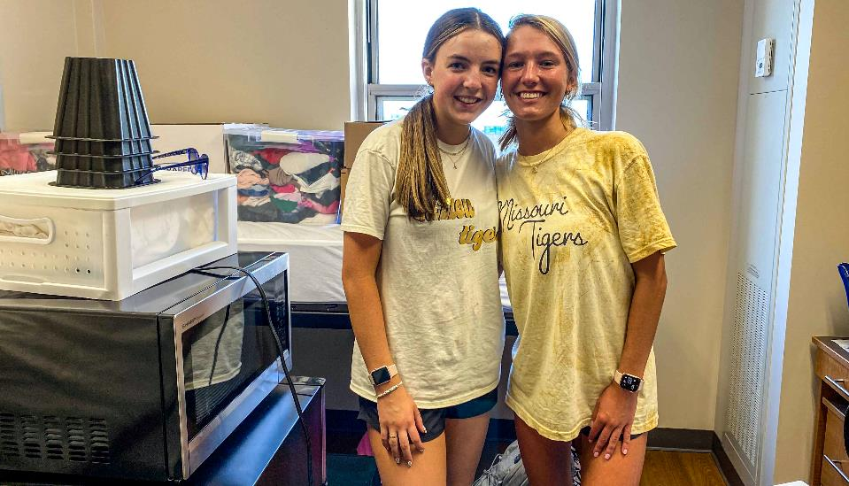
Welcome back, Tigers, Roos, Miners and Tritons!
2

Slide 3
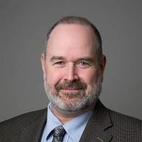
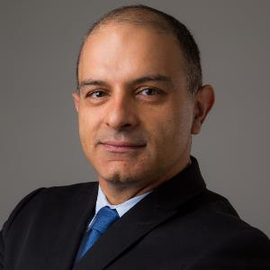
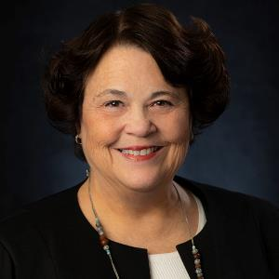
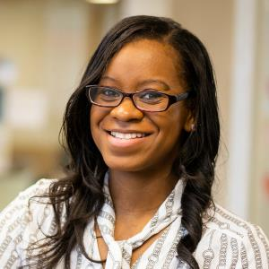
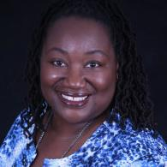
2021 UMKC Presidential Awardees
Dr. Andrew Bergerson
Cross-Cultural Engagement
Dr. Reza Derakshani
Economic Development
Dr. Wanda Temm
Innovative Teaching
Dr. Janet Garcia-Hallett
Intercampus Collaboration
Dr. LaVerne Berkel
University Citizenship- Service
3

Slide 4
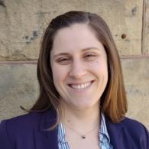
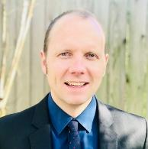
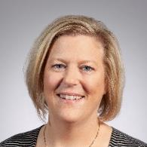
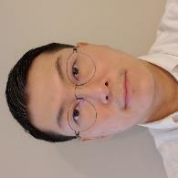
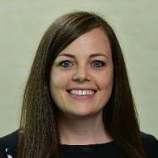
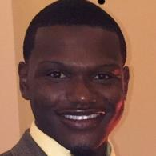
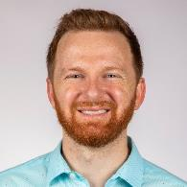
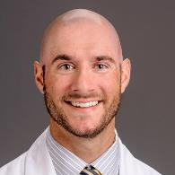
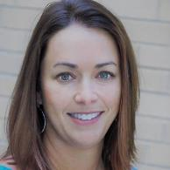
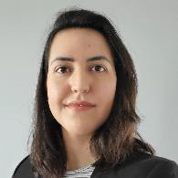
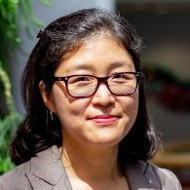
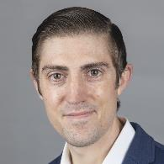
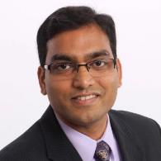
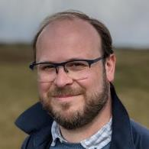
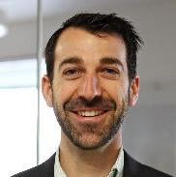
New Faculty - MU
Current recommendation from Chris Riley-Tillman is to not use Bernard until we have an official start date; we are tracking with them to see if this can be added before the meeting. Prof. Driver has an official start date now.
Kathleen Rose, Asst. Prof.
Science Communication
University of Wisconsin
Zachary Massey, Asst. Prof.
Science Communication
University of Oklahoma
Kerri McBee-Black, Asst. Prof.
Textile and Apparel Mgmt
MU
Junghwan Kim, Asst. Prof.
Radiology
University of Pittsburgh
Mary Cowx, Asst. Prof.
Accountancy
Ohio State University
Chartese Jones, Asst. Prof.
Mathematics
University of Mississippi
Jordon Wade, Asst. Prof.
Natural Resources
Ohio State University
Steven DeFroda, Asst. Prof.
Orthopaedic Surgery
Drexel University
Keri Jacobs, Assoc. Prof.
Applied Social Science
NC State University
Debora Verniz, Asst. Prof.
Architecture
Penn State
So-Yun Park, Asst. Prof.
Plant Sciences
Seoul National University
Andrew Kiselica, Asst. Prof.
Health Psychology
University of South Florida
Bhanu Telugu, Assoc. Prof.
Animal Science
MU
Robert Fletcher, Prof.
Health Psychology
Oxford
Craig Schenck, Asst. Prof.
Agriculture Biochemistry
University of Wisconsin
Notes:
photos

Slide 5
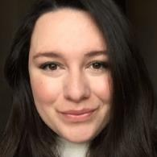
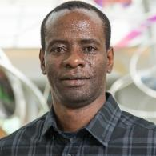
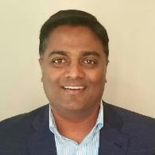
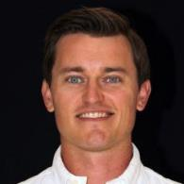
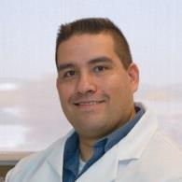
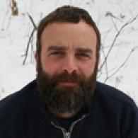
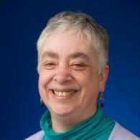
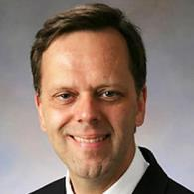
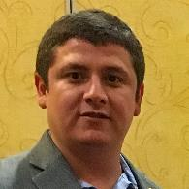
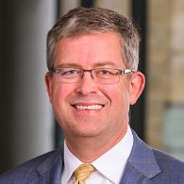
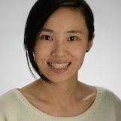
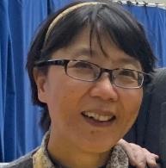
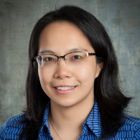
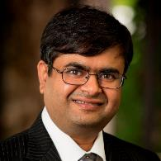
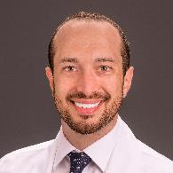
Rachael Hernandez,
Asst. Prof.
Communication
IUPUI
Enoch Ng’oma, Asst. Prof.
Biological Science
Friedrich Schiller University Jena
Lakshmikantha H Channaiah,
Asst. Prof.
Food Science and Nutrition
Kansas State University
Victor Outlaw, Asst. Prof.
Chemistry
Johns Hopkins University
(University of Wisconsin)
Jorge Gomez-Gutierrez,
Assoc. Prof.
Child Health Administration
University of Nuevo León
Michael C. Stambaugh,
Assoc. Prof.
Forestry
MU
Anne Sales, Prof.
Nursing
University of Minnesota
(University of Michigan)
Paul Carney, Prof.
Child Health- Neurology
Universidad de Valparaiso
(UNC Chapel Hill)
Oliver Giraldo-Londoño,
Asst. Prof.
Civil Engineering
Georgia Institute of Technology
Russ Waitman, Prof.
Health Management & Informatics
Vanderbilt University
(University of Kansas Medical Center)
Xing Song, Asst. Prof.
Health Management and Informatics
UMKC
Jullie Pan, Asst. Prof.
Radiology
Yale University
(University of Pittsburgh MRRC)
Ai-Ling Lin, Assoc. Prof.
Radiology
UT Health San Antonio
(University of Kentucky)
Akhil Srivastava, Assoc. Prof.
Anatomic Pathology
University of Hawai’i at Mānoa
(University of Oklahoma)
Daniel London, Asst. Prof.
Orthopaedic Surgery
Case Western Reserve University
Notes:
photos

Slide 6
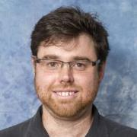
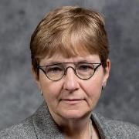
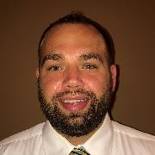
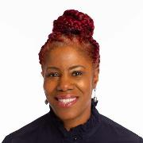
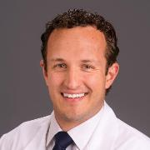
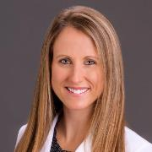
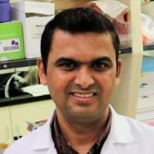
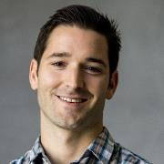
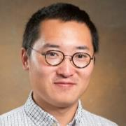
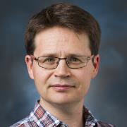
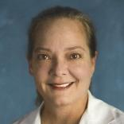
Jeffrey Wood, Asst. Prof.
Ecosystem Science
University of Guelph
Heike Buecking,
Prof. and Director
Plant Sciences
University of Bremen, Germany
Scott Zawieja, Asst. Prof.
Medical Pharmacology/Physiology
Texas A&M University
Idethia Shevon Harvey, Assoc. Prof.
Health Sciences
University of Pittsburg
(Texas A&M University)
Clayton Nuelle, Asst. Prof.
Orthopaedic Surgery
Loyola University of Chicago
Julia Nuelle, Asst. Prof.
Orthopaedic Surgery
Loyola University of Chicago
Pawan Singh, Asst. Prof.
Ophthalmology
Jiwaji University, India
Zachary Berndsen, Prof.
Biochemistry
UCSD
Changyu Sun, Asst. Prof.
Biological Engineering
INSA de Lyon
John Driver, Assoc. Prof.
Animal Science
University of Georgia
(University of Florida)
Jean Goodman, Prof.
OBGYN & Women’s Health
Georgetown University
(Loyola University)
Melissa Terpstra, Asst. Prof.
Radiology
University of Minnesota
(University of Minnesota)
Stephen Sheinkopf, Prof.
Developmental-Behavioral Pediatrics
University of Miami
(Brown)
Clarissa Durie, Assoc. Prof.
Biochemistry
UAB
(University of Michigan)
6

Slide 7
New Faculty - UMKC
Carl Allen, Prof.
Jazz Studies
Honorary PhD – Snow College
(Julliard)
Leigh Muñoz, Asst. Prof.
Bassoon
University of Kansas
(Middle Tennessee State University)
Ebonee Thomas, Asst. Prof.
Flute
MA – New England Conservatory of Music
Noel Torres-Rivera, Asst. Prof.
Music Theory
Graduate Center, CUNY
Mo Zhou, Asst. Prof.
Stage Directing
Columbia University
Xiangming Zha, Assoc. Prof.
School of Pharmacy
University of Iowa
(University of South Alabama)
Steven Onken, Assoc. Prof.
Social Work
University of Texas-Austin
(University of Northern Iowa)
Michelle Garrido Briner, Asst. Prof.
Dental Surgery
University of Los Andes, Chile
Notes:
photos

Slide 8
New Faculty – S&T and UMSL
Karen Head, Prof.
English and Arts
University of Nebraska
(Georgia Institute of Technology)
Hyunsoo Kim, Asst.Prof.
Physics
Iowa State University
(Texas Tech University)
Colin Potts, Provost and Prof.
Computer Science
Sheffield University
(Georgia Institute of Technology)
Dawei Wang, Asst. Prof.
Business and Information Technology
University of Oklahoma
(University of Michigan-Dearborn)
Steven Berberich,
Interim Provost
Biomedical Sciences
Wright State University
(University of Houston – Clear Lake)
Magen Rooney-Kron, Asst. Prof.
Special Education
University of Illinois at Urbana-Champaign
Rachel Winograd, Assoc. Prof.
Psychological Sciences
MU
(MIMH)
Notes:
photos

Slide 9
Missouri S&T Faculty to be Knighted
Dr. Audra Merfeld-Langston
Chair of Arts, Languages and Philosophy;
Associate Professor of French
Received the title Chevalier in the French government's Ordre des Palmes Academiques in recognition of her outstanding teaching, scholarship and leadership over the course of her career.

Slide 11
Admissions Update
Freshmen Applicants
Transfer Applicants
8/2021 | 2019 | 2020 | 2021
MU | 20,044 | 20,655 | 19,977
UMKC | 5,940 | 5,657 | 5,840
S&T | 5,076 | 5,527 | 5,548
UMSL | 3,706 | 3,771 | 3,154
8/2021 | 2019 | 2020 | 2021
MU | 3,158 | 3,561 | 3,108
UMKC | 2,868 | 2,470 | 2,318
S&T | 715 | 588 | 579
UMSL | 3,716 | 3,789 | 3,478
Freshmen Accepted (with deposit)
Transfer Accepted (with deposit)
8/2021 | 2019 | 2020 | 2021
MU | 5,664 | 5,730 | 5,147
UMKC | 1,294 | 1,228 | 1,445
S&T | 1,197 | 1,190 | 1,511
UMSL | 472 | 445 | 363
8/2021 | 2019 | 2020 | 2021
MU | 1,160 | 1,422 | 1,494
UMKC | 1,108 | 1,178 | 1,241
S&T | 292 | 262 | 272
UMSL | 1,247 | 1,296 | 1,367
Notes:
At 4 weeks until Census, opening day

Slide 12
Total Enrollment (All Full-Time Students)
8/2021 | 2019 | 2020 | 2021 (Estimate)
MU | 25,058 | 25,781 | 25,572
UMKC | 9,380 | 9,028 | 9,133
S&T | 6,593 | 6,164 | 5,919
UMSL | 5,986 | 5,786 | 5,126
Notes:
At 3 weeks until Census as of Monday, 8/30/2021 - no restrictions on degree-seeking status

Slide 13
Student Success
Omiya Hassan (Grad Student)
Engineering
Divya Jain (BA-MD Program)
Medicine
1 of 3 global recipients of the IEEE IMS Graduate Fellowship Award
Jerome Grossman Graduate Fellow in Healthcare Policy at Harvard
David Lund (Graduate Student) Engineering
Ayomide Aruwajoye (UG)
Nursing
2021 NASA Space Tech Fellowship Recipient
Inaugural Loretta Ford Centennial Scholarship Recipient
13

Slide 15
FY21 Federal R&D Proposals (July 1 – June 30)

Slide 16
FY 21 Federal R&D Awards (July 1 – June 30)

Slide 17
Federal R&D Expenditures (July 1 – June 30)
Notes:
I matched MU's to Jamie's weekly spreadsheet for Federal R&D Expenditures, then summed the revised MU with 3 other campuses to get new total for UM System.

Slide 18
MU Major Grants and Awards
Mun – this is a great opportunity to talk about Tom's official new role as VCR at Mizzou
Endometrial Basis for Infertility in Women with Recurrent Implantation Failure and Pregnancy Loss
PI: Professor Thomas Spencer; Co-PI: Dr. Alan Decherney
$3.2 M
Sponsor: NIH National Institute of Child Health & Human Development
Women with endometriosis are at risk for higher rates of early pregnancy loss. This fundamental work will generate knowledge that can be translated to improve reproductive outcomes of natural and assisted pregnancies and understand the origins of common gynecological and reproductive disorders in women.
18

Slide 19
MU Major Grants and Awards
Coacervates for localized and sustained delivery of immunomodulators to prevent islet allograft rejection
PI: Dr. Haval Shirwan; Co-I: Dr. Esma Yolcu
$2.2M
Sponsor: Department of Defense
This project looks to improve the treatments for Type 1 Diabetics. Insulin is made from pancreatic islets, which are destroyed by the T1D patients’ own immune system. A clinical trial involving transplantation of pancreatic islets has proven a promising therapy, but most islet transplant patients do not maintain long-term graft survival. Dr. Shirwan is working on an approach that will control rejection and maintain transplant survival.
19

Slide 20
NextGen Precision Health Update
Grand Opening of the NextGen Precision Health Building on October 19
25-ton Siemens Healthineers MAGNETOM Terra 7-Tesla magnetic resonance imaging scanner (7T MRI) arrived August 4
Building name opportunity
20

Slide 21
Philanthropy (July 1- June 30)
Notes:
5 year breakdown by campus/system

Slide 22
Guiding Principles Going Forward
THANK YOU

